Slide 1
Effect of Beer Consumption on Reaction Time in Athletes: A Ruler Test Analysis
Jake Nielsen

Slide 2
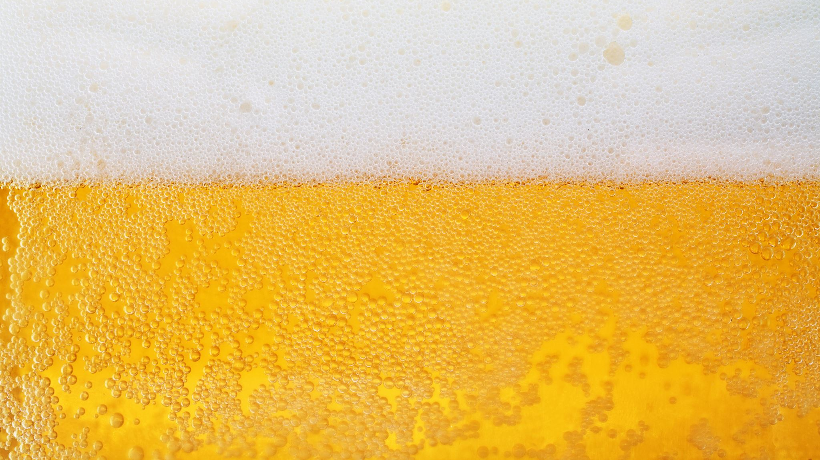
Introduction
Research Question: Does consuming beer before athletic performance affect the muscles, thus potentially reducing injury severity?
Reduction of injuries Longer playing careers Increase money for sports
Notes:
Use this slide to give the overall aims of your study and explain why the study is interesting.

Slide 3
Aim
Hypothesis: Athletes who consume beer before performing have slower reaction times due to muscle relaxation, potentially leading to reduced injury severity
- H₀: There is no difference in reaction times between athletes who consume beer and those who do not, regardless of sex
- H₁: There is a difference in reaction times between athletes who consume beer and those who do not, regardless of sex
Variables:
- Explanatory: Alcohol consumption (beer vs. no beer), and sex (male vs. female)
- Response: Reaction time (Ruler test: before and after consumption)

Slide 4

Participants
Sample Size: 44 participants (22 males, 22 females), aged 20-30, run club
Random Assignment: Divided into beer and control groups
Testing Procedure: Reaction times were measured using the ruler drop test, both before and after beer consumption
Notes:
Use this slide to give the target population and sample size, and to describe how participants were selected for the study.

Slide 5
Methods
Study Design: A 2x2 factorial design:
1. Alcohol consumption (yes/no)
2. Sex (male/female)
Response Variable: Reaction time difference (before beer /after beer)
Statistical Analysis: Two-way ANOVA to assess the effect of alcohol and sex on reaction times, plus residual checks for normality
Notes:
Use this slide to further describe the methods, such as how data was obtained or the protocol for tasks, and the statistical test to be used in the analysis.

Slide 6
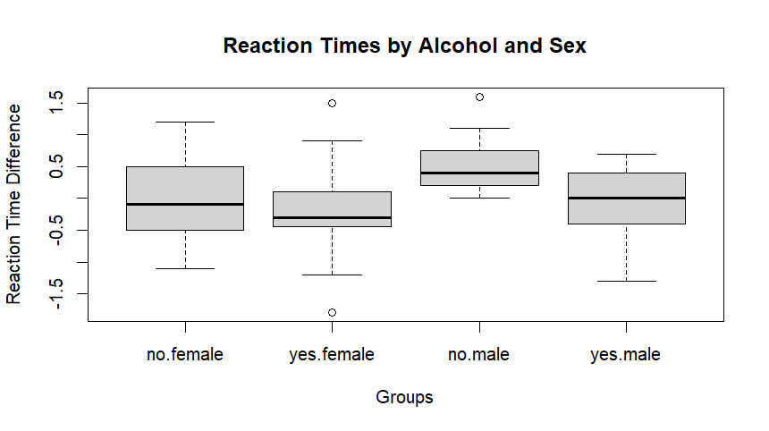
No strong differences
There is no strong interaction
Notes:
Use this slide to give an appropriate figure to describe the key features of the data. Create new blank slides for any additional figures, as needed.

Slide 7
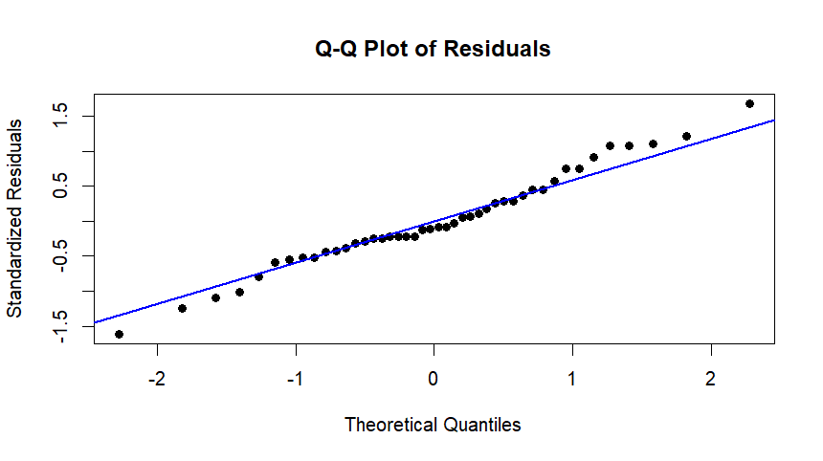
Residuals are normally distributed
No major deviations from normality
Notes:
Use this slide to report the test statistic/s and p-value/s from your chosen tests.

Slide 8
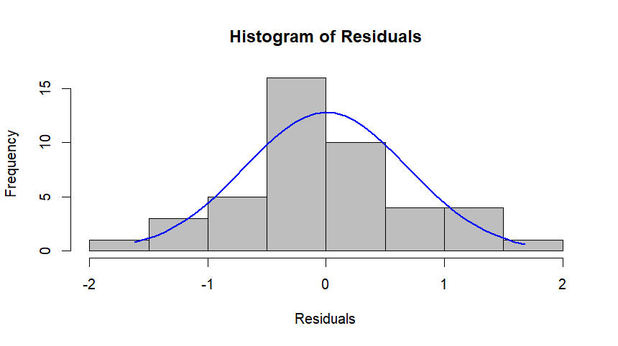
The residuals are centered around zero and approximate a normal distribution
Notes:
Use this slide to report the test statistic/s and p-value/s from your chosen tests.

Slide 9

Results
There is no evidence that Alcohol interaction has a significant effect on reaction times based on the p-values
$R^{2}$= 13.77%
Notes:
Use this slide to give summary statistics. For example, this could be a table of the sample sizes, means, and standard deviations in each group.

Slide 10
Conclusion
Key Findings:
No significant effect of alcohol or sex on reaction times (p-values above 0.05)
Males exhibited slightly slower reaction times after consuming alcohol, but the effect was not statistically significant
Implications: These findings suggest that alcohol consumption does not significantly impact athletes' reaction times enough to affect injury risk
Notes:
Use this slide to summarise the findings of the study in relation to the aims.

Slide 11
Discussion
Limitations:
- Small sample size
- Only used the ruler test as a measure of reaction time, which may not fully capture the impact of alcohol on injury severity.
Future Research:
- Consider increasing sample size
- Investigate other response variables, such as injury severity or reaction times in real-world sports contexts.
Notes:
Use this slide to provide a discussion of the findings, highlighting any limitations.

